Slide 1


Notes:
LLC, Amsterdam-based
Restore degraded land through reforestation
Focus on data

Slide 2
Table Of Contents
Notes:
Concepts
RQ’s & RM
Ontology creation
Time
Complexity
Automation
Conclusions

Slide 3
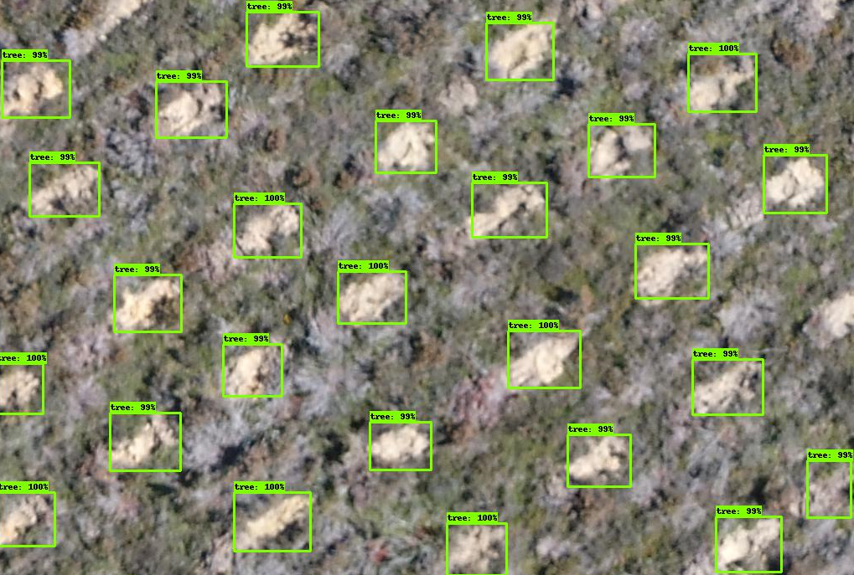
Reforestation
Fig 3.1: Comparison of tree height per treatment for trees near McAllen, Texas.
Fig 3.2: Visualisation of tree recognition software output.
Notes:
Forestry and data; many variables, analytical approach not feasible. Early adopter of statistical methods
Many different models tried (nearest neighbour models, random forests, regression)
Early neural network, implementation would now be seen as silly
[Slide]
BN mentioned as promising

Slide 4
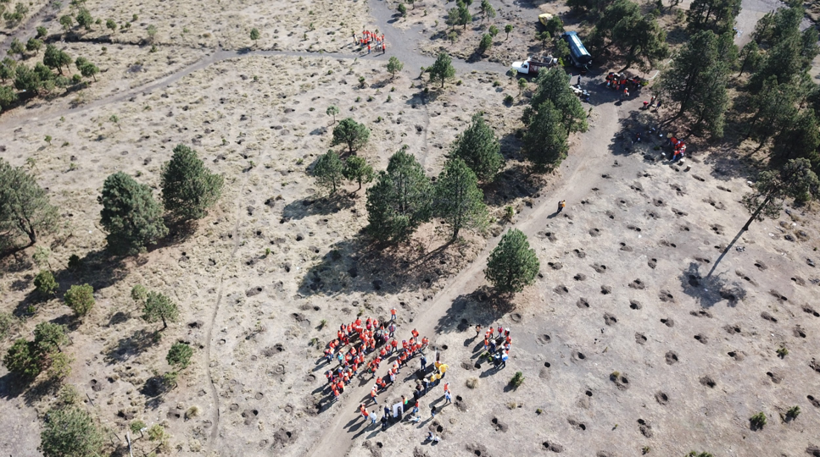

“Despite their potential, BNs have barely been applied in Environmental Sciences.”
PA Aguilera et al. “Bayesian networks in environmental modelling”. In:
Environmental Modelling & Software 26.12 (2011), pp. 1376–1388.

Slide 5
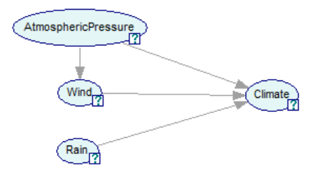
Bayesian Networks
Fig 5.1: Example of the graphical structure of a (small) Bayesian network
Notes:
Probabilistic model, Graphical structure and probabilities
Nodes, arcs indicate possible correlation

Slide 6
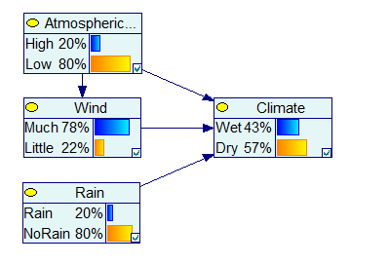
Bayesian Networks
Fig 6.1: The same Bayesian network, processed in GeNIe.
Notes:
Strengths of BN’s: Relatively easy interpretation, explicit use of domain knowledge
Downside: Much effort to construct
Construction through data or by domain experts
Complexity: remove arcs, nodes or values, parent divorcing
[Slide]
Alternative construction technique: ontologies

Slide 7
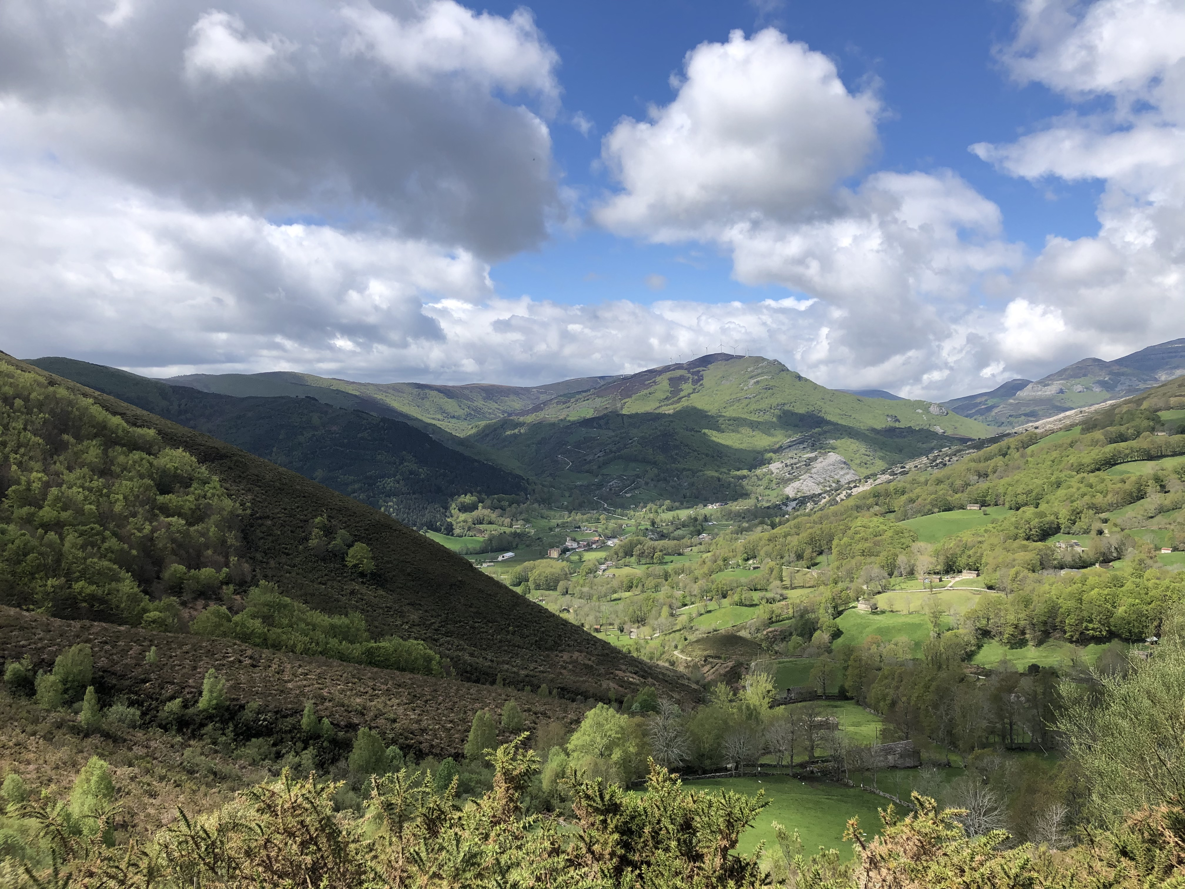
“It would be desirable to incorporate the fruits of these efforts [on ontologies] in Bayesian networks.”
Dawn E Holmes. Innovations in Bayesian networks: theory and applications. Vol. 156. Springer, 2008.

Slide 8
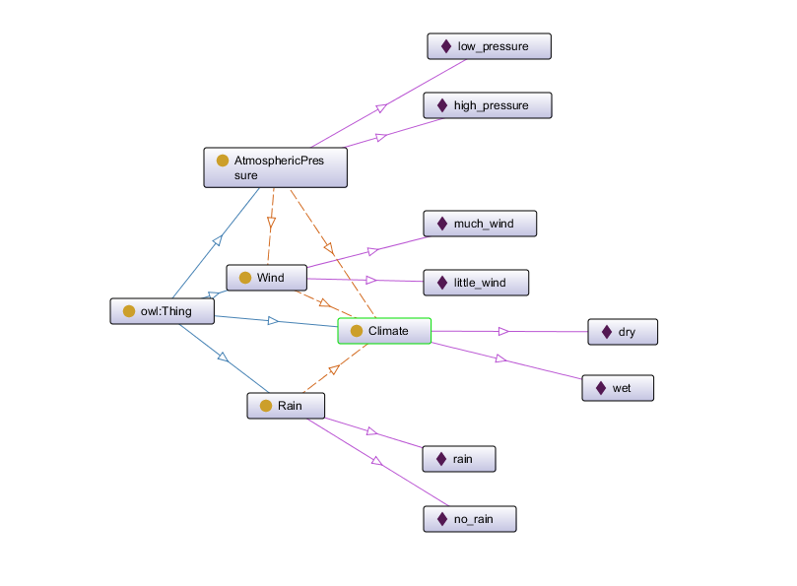
Ontologies
Fig 8.1: Part of the ontology built for this research visualized in Protégé using OntoGraf.
Notes:
Represent any knowledge in graph
Taxonomic Relation

Slide 9
Bayesian Networks to Ontologies
Notes:
Similarities in graphical structure
Ontologies are readily available for some domains
Handful of methods exist, but none too extensively studied

Slide 10
Research Questions
Can an ontology help a company like Land Life Company model their data in a Bayesian Network?
What challenges does one encounter when applying existing methods in creating Bayesian Networks from ontologies?
How can existing methods in creating Bayesian Networks from ontologies be adapted to become better applicable for companies like Land Life Company?
Notes:
Read out questions

Slide 11
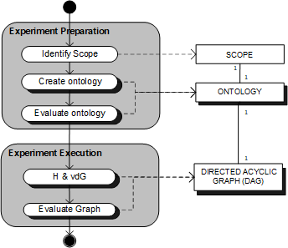
Research Method
Fig 11.1 A PDD describing the Research Method used in this research.
Notes:
Ontology creation, merging, part of process for most companies making transformation
Ontology Evaluation with domain experts
Single Case-Study
Bayesian Network Evaluation with domain experts

Slide 12
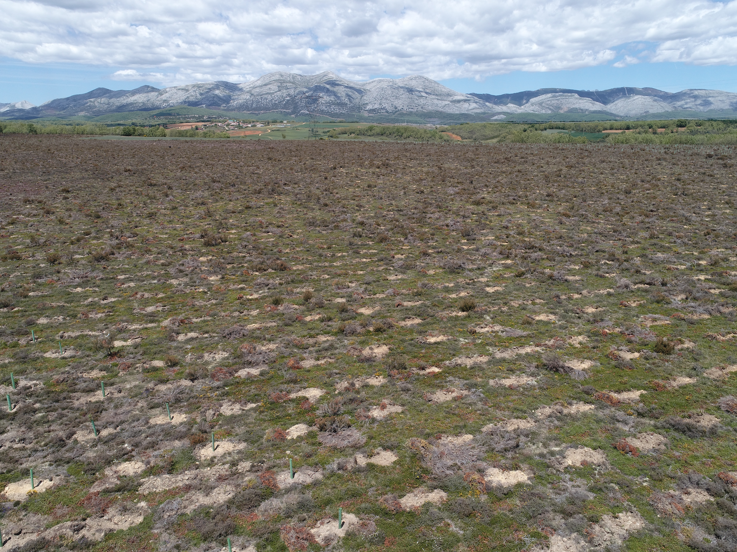
“Can an ontology help a company like Land Life Company model their data in a Bayesian Network? ”

Slide 13
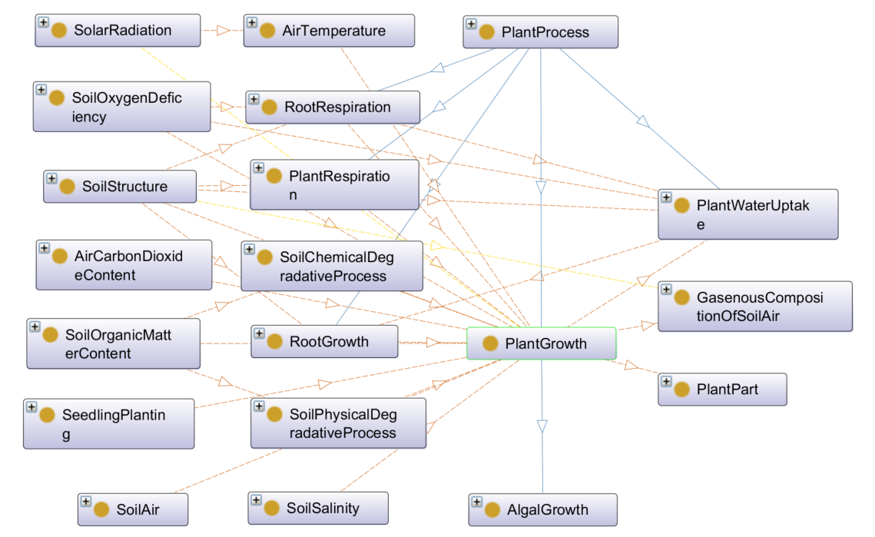
Ontology Creation
Fig 13.1 Part of the ontology created for this research after merging existing ontologies.
Notes:
Ontology Creation
Merging without tool, existing methods require too much time to get acquainted to

Slide 14
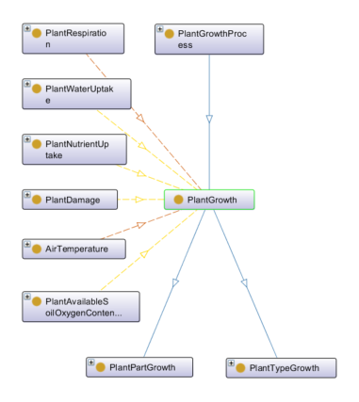
Ontology Evaluation
Fig 14.1 Part of the ontology created for this research after domain expert evaluation.
Notes:
Ontology Evaluation
Many changes, missing relations in merged ontologies, lacking domain knowledge required for merging

Slide 15
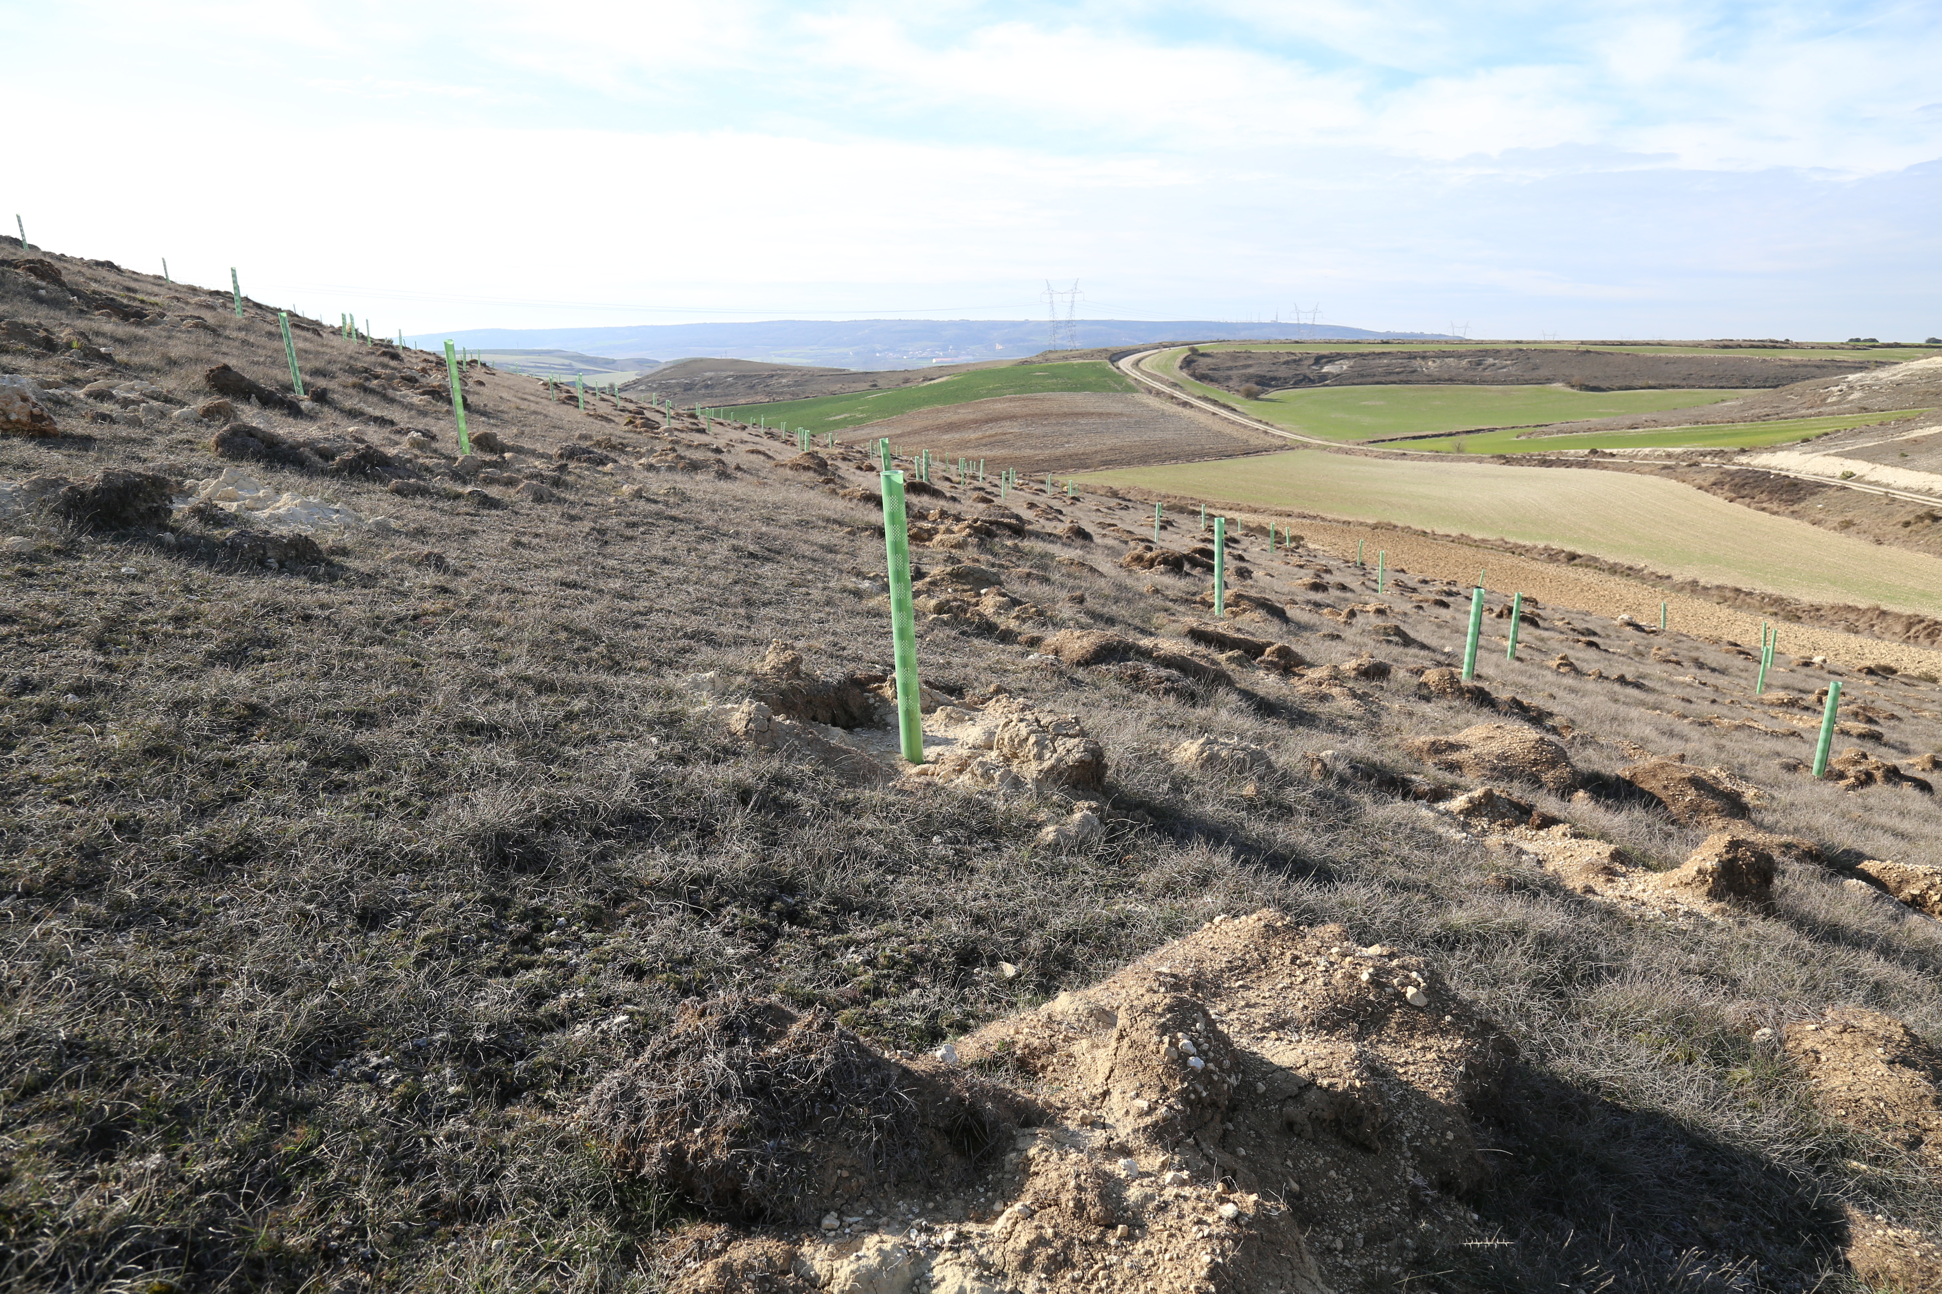

Slide 16



Bayesian Network Creation
Process Outline:
Entity Selection
Bayesian Network Graph Creation
Probability Learning
Notes:
Described in detail in thesis
For now, 3 steps
Probability Learning is omitted in this research

Slide 17
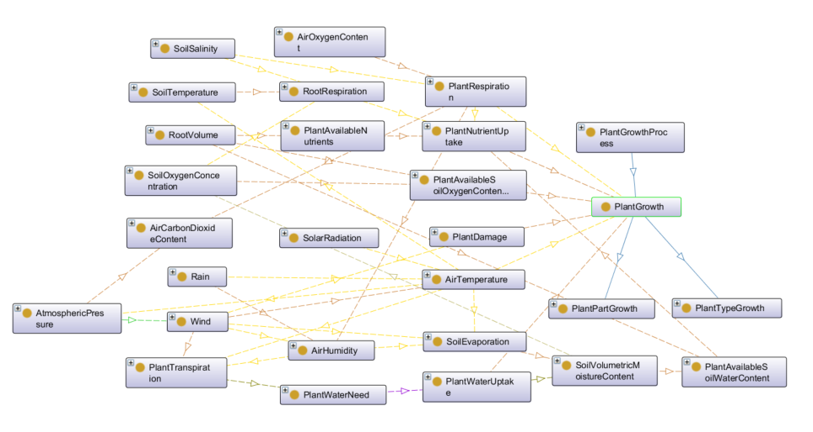
Entity Selection
Fig 17.1 Part of the ontology created for this research after entity selection.
Notes:
Figure shows more of ontology after evaluation
Scope Selection covered by ontology merging
Measurable Entity Selection: Soil Temperature
Time: Rainfall and PlantGrowth are measured aggregated over some amount of time

Slide 18
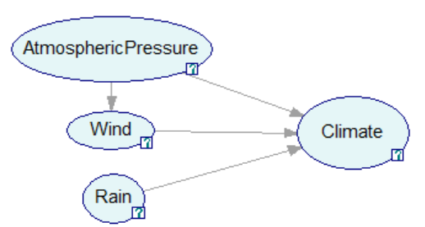
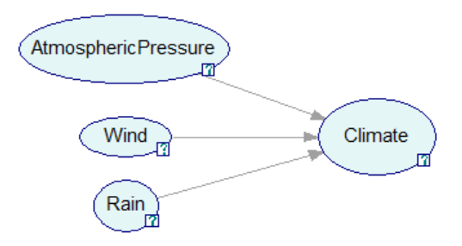
Entity Selection
Fig 18.1 A Bayesian network graph indicating that atmospheric pressure and wind are dependent on a short time scale.
Fig 18.2 The same graph for a longer time-scale.
Notes:
Most current methods do not account for time
(Some do: DBN’s)
Time as scope

Slide 19
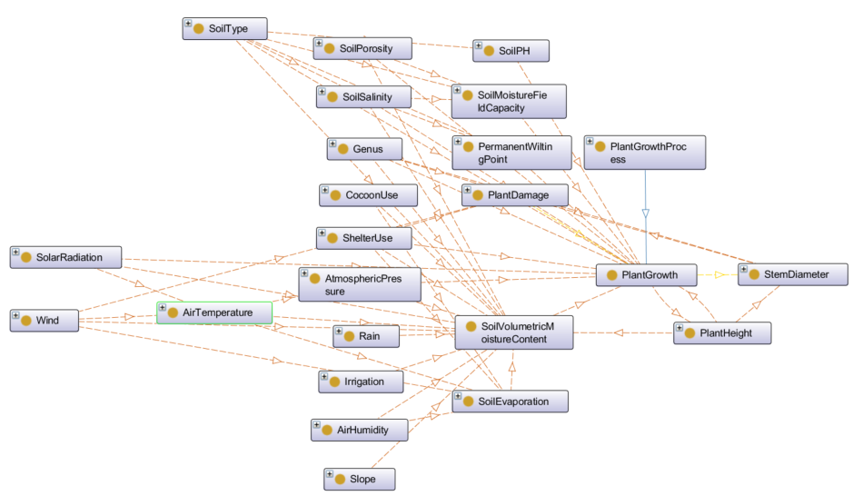
Entity Selection
Fig 19.1 Part of the ontology created for this research after domain expert evaluation.
Notes:
Semi-structure interview
Reviewed correctness, accuracy and granularity on graph fragments

Slide 20
Graph Creation
Process Outline:
Entity Selection
Bayesian Network Graph Creation
Probability Learning
Notes:
Described in detail in thesis
For now, 3 steps
Probability Learning is omitted in this research

Slide 21
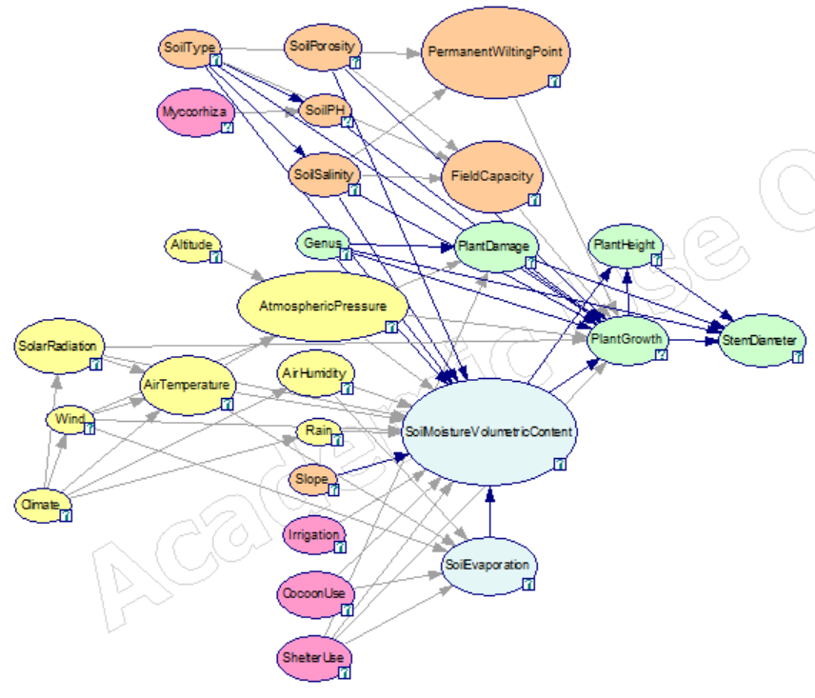
Graph Creation
Fig 21.1 A Bayesian network created for this research.
Notes:
Entities to nodes, relations to arcs
Removed some cycles
Complexity (~10^7 probabilities)
Two techniques, removing arcs/nodes/values & parent divorcing
Removed some soil characteristics and aggregated weather into climate

Slide 22


Graph Creation
Two Options:
Removing Nodes/Arcs/Values
Divorcing Parents
Fig 22.1 A Bayesian network created for this research.
Notes:
Entities to nodes, relations to arcs
Removed some cycles
Complexity (~10^7 probabilities)
Two techniques, removing arcs/nodes/values & parent divorcing
Parent Divorcing required adding nodes
Removed some soil characteristics and aggregated weather into climate

Slide 23
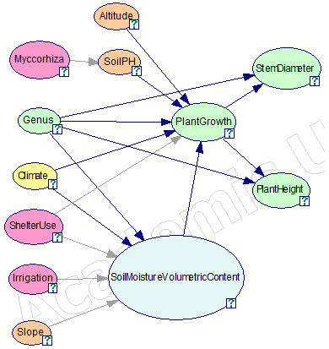
Graph Creation
Fig 23.1 A Bayesian network created for this research.
Notes:
~1000 probabilities
Underwhelming: not very expressive

Slide 24
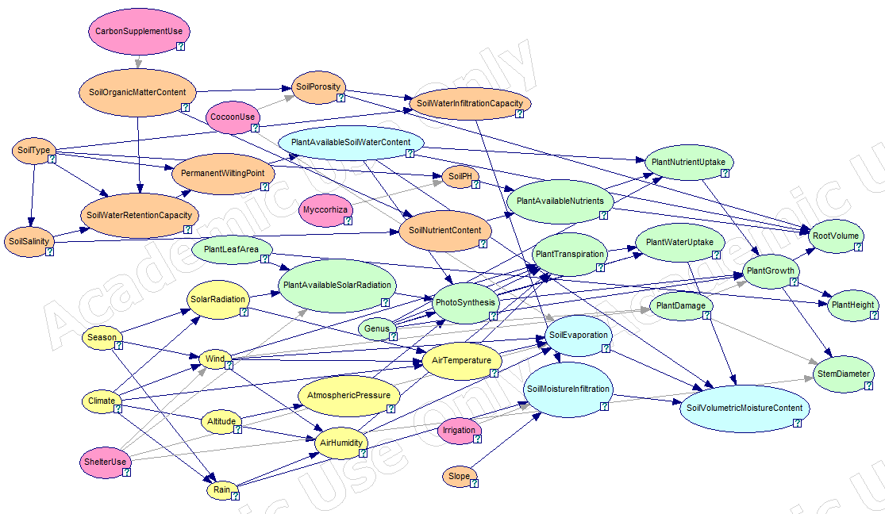
Graph Creation
Fig 24.1 A Bayesian network created for this research.
Notes:
~1000 probabilities

Slide 25
Graph Evaluation
Fig 25.1 A Bayesian network created for this research.
Notes:
Semi structured interviews
Positive about the model in general
Probabilities needed to assess applicability within as well as outside of LLC

Slide 26
Graph Creation
Process Outline:
Entity Selection
Bayesian Network Graph Creation
Probability Learning
Notes:
Method similarity: graph creation
Method differences: Entity Selection & Graph checking, overview given in thesis.
General automated tool
OWL,

Slide 27
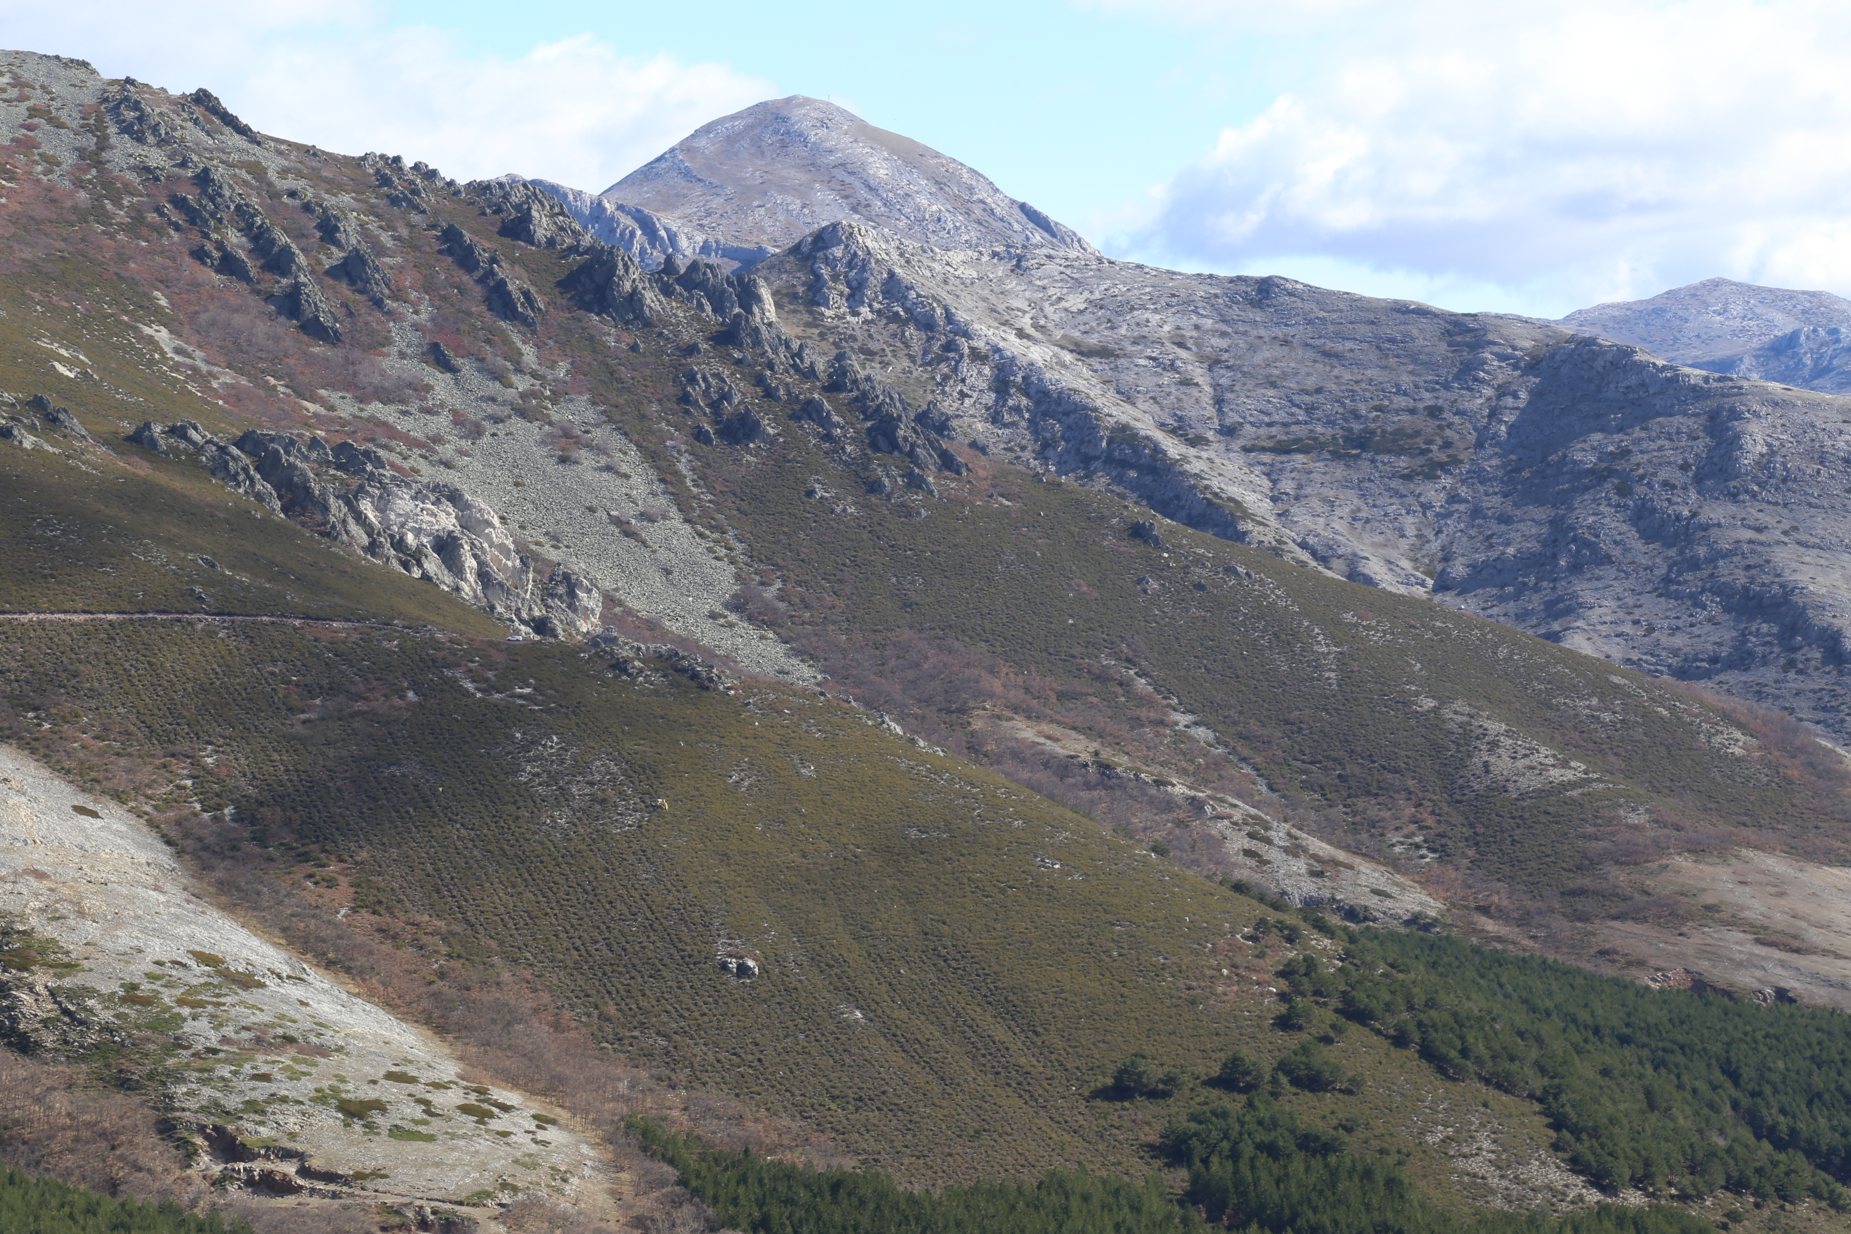

Slide 28
Conclusion
Can an ontology help a company like Land Life Company model their data in a Bayesian Network?
What challenges does one encounter when applying existing methods in creating Bayesian Networks from ontologies?
How can existing methods in creating Bayesian Networks from ontologies be adapted to become better applicable for companies like Land Life Company?
Notes:
Challenges:
Time: Unclear how to process role of time in methods
Complexity: Trade-off between expressiveness and complexity
Automation: methods are similar and repetitive
Adaption:
Time: some tools identified: (DBN) time as selection criterion
Complexity: should be kept in mind during entity selection
Automation: general automated tool could speed up

Slide 29
Conclusion
What challenges does one encounter when applying existing methods in creating Bayesian Networks from ontologies?
Notes:
Challenges:
Time: Unclear how to process role of time in methods
Complexity: Trade-off between expressiveness and complexity
Automation: methods are similar and repetitive

Slide 30
Conclusion
How can existing methods in creating Bayesian Networks from ontologies be adapted to become better applicable for companies like Land Life Company?
Notes:
Adaption:
Time: some tools identified: (DBN) time as selection criterion
Complexity: should be kept in mind during entity selection
Automation: general automated tool could speed up

Slide 31
Conclusion
Can an ontology help a company like Land Life Company model their data in a Bayesian Network?
Notes:
Yes, but it can be improved upon

Slide 32
Thanks!

